Slide 1


Welcome
Meet the Teacher
Year 4

Slide 2

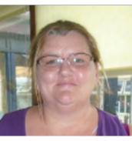
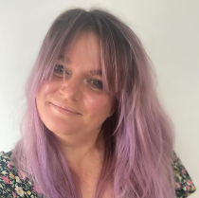
Year 4 Teaching Team
Mr Amos
Mrs Chem
Mrs Harvey
Other adults in the year group
Miss Smith, Miss Clark, Miss Evans, Mrs Nicholls and Miss Woodhams

Slide 3

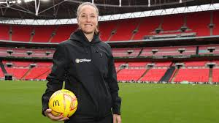

Year 4 Classes
4A will be Stoney Class
4C will be Jazzie Class

Slide 4
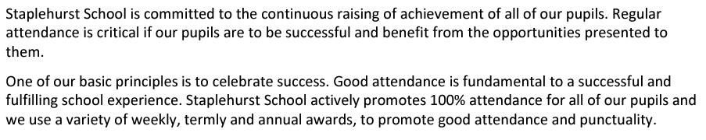
School timings
Attendance: It is essential to be in as much as possible to maximise learning and give children the best chances at success and integration. As our attendance policy quotes:
Term starts (for children) on Tuesday 2nd September.
Drop off as normal 8:35 – 8:50am through gate.
Learning starts 8.35am, children should be in class at this time ready to begin.
Pick up - Gate opens at 3:10pm. Classroom dismissal = 3:15pm via the external classroom doors.

Slide 5

Vision

Slide 6
Expectations at Staplehurst
At Staplehurst School, we show…
Positivity
  A positive attitude to school and learning.
  Being kind and supportive to each other.
Respect
  Showing respect to adults and each other.
  Being polite and well behaved in the classroom and around school.
Independence
  Being independent and motivated with learning.
Determination
  Being determined and resilient learners.
  100% effort at all times.
Excellence
  Setting a good example to the rest of the school.
  Demonstrating excellence in behaviour, attitude and learning.

Slide 7

Rewarding pupils showing our PRIDE Values
PRIDE Points & PRIDE Rewards
Verbal praise
Certificates in Celebration Assembly
Reward equipment at playtime
Prizes e.g. Books for 30 reads
Non-uniform days – house PRIDE winners

Slide 8
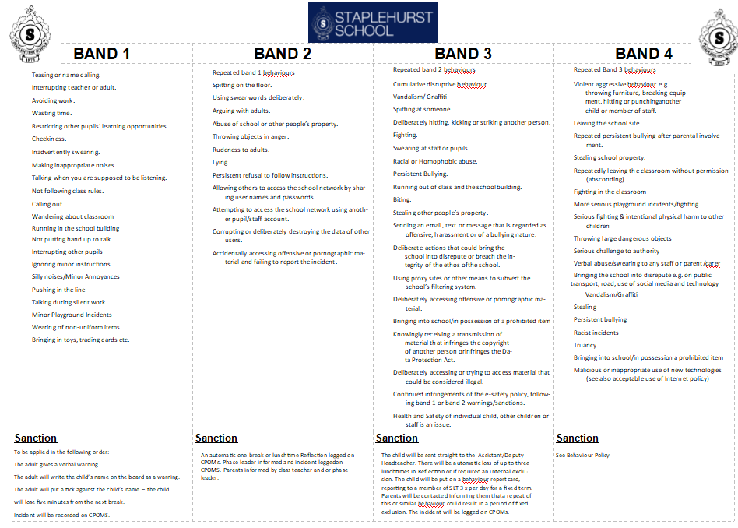
When behaviour does not meet standards
As per our policy, we band behaviour accordingly. Whilst our approach is always restorative and preemptive, when we do encounter behaviour that doesn’t meet the high-expectations we have, the following measures/procedures are considered:
Teachers will put names on the board and ticks next to them to offer children chances to correct behaviour before escalation.
Reflections (a restorative lunchtime session where the child spends time with a senior leader, completing a restorative activity to help reflect on behaviour, followed up with a reconnecting conversation with the adult.
Repeated reflections (x3 in one term) will result in a meeting with the headteacher and parents/carers.
Any behaviour of low-level will be communicated by the class teacher to parents and carers at the end of the day. This is to support everyone in moving the behaviour forward positively.

Slide 9
Reading
Reading should be recorded in contact books daily. Contact books will be checked weekly. Pupils aim for 30 reads rewards.
Messages should go via the year group email, or urgent messages e.g. pickup or appointments via the office.
All medical requests need to go via the school office to ensure all are informed.
Daily reading lessons. Fluency and Extended read sessions build fluency, vocabulary and prosody (reading with expression and relevant speed). Close read sessions develop analysis of the text.

Slide 10
School uniform, PE Kit and other equipment.
Winter uniform.
Winter uniform as per policy. One pair of stud earrings only. Bows in navy or school yellow and no bigger than the palm of your child’s hand. Hair below shoulders needs to be tied back.
Blue P.E. t-shirt, blue or black shorts, plimsolls/trainers
Tracksuits or sweatshirts (blue or black) may be worn when cold. No leggings. Sweatshirts should not have a hood. Hair must be tied back, and no jewellery should be worn.
If your child is unable to take part in P.E, please send in a note/email to explain why. Repeated missing kit will result in reflection.

Slide 11


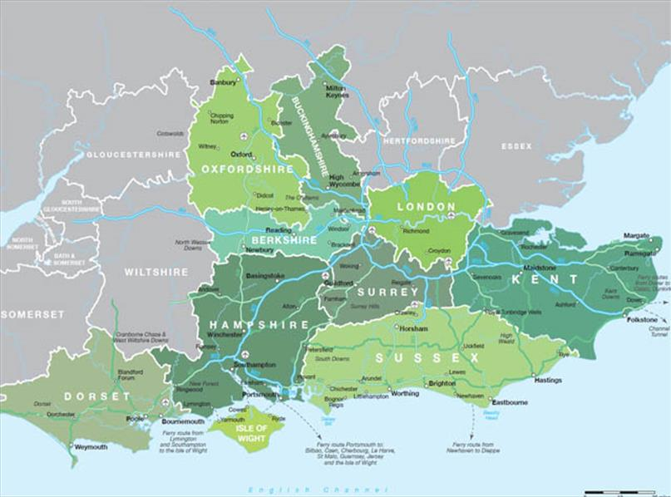
Curriculum Coverage
T1) What are the similarities and differences between Ancient Civilisations? (History)
T2) Why are rivers important and how do humans influence them? (Geography)
T3) Why was the River Nile significant to the longevity of the Ancient Egyptian Civilisation? (History)
T4) How are humans affecting the world’s rainforests? (Geography)
T5) How did the Anglo-Saxons and Vikings change England? (History)
T6) How is land used in South East England? (Geography)
Curriculum themed weeks STEM Week, World Week, Keeping Healthy Week

Slide 12
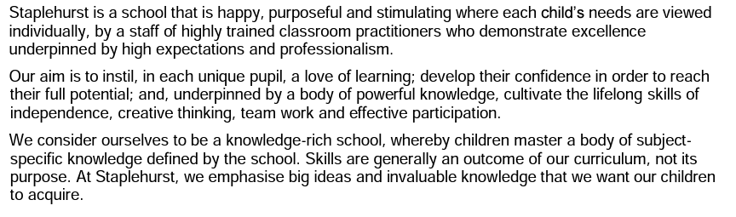
Quality-First Teaching
Our teaching and learning policy captures our approach to how children at Staplehurst learn:
Same-Day Intervention
Formative assessment
Retrieval Practice
Effective use of feedback
Quality first teaching
Precision teaching

Slide 13
Homework
One piece of Maths & Spelling/SPAG every week.
30 minutes a week.
Focus on consolidation of key concepts taught. Homework should not be overly challenging with the intention to offer opportunity to practice, increase confidence and boost speed/stamina of working.
To be handed out on a Friday and handed back in by Tuesday. Completion will be expected.
Children also need to be reading every night, and practise times tables (including division facts).
Please remember to fill in the reading record (PRIDE Points are given). Pupils can aim for 30 reads rewards.

Slide 14
Ways to help your child at home
Helping to ensure your child arrives at school on time every day.
Regular reading (aim for 30 reads).
Times tables practice. (TT Rockstars)
Ensuring homework is completed and handed in on time, and when completing internet research, aiding children in finding key points.
Visiting the library to research topics.
Visiting places of interest
Support pupils with holiday learning tasks.

Slide 15
School Library
Each group will visit the library weekly
We encourage the children to use this time to read for pleasure
They are allowed to bring one 'read for pleasure' book home from the library
They must return it on the following visit to be able to sign out a new book
You will also be able to visit the library with your child after school
Library times are:
Tuesday and Thursday 3.30pm-4.00pm
If they take a book, please sign it out in their blue year group folder

Slide 16
MTC
The Multiplication Tables Check (MTC) is statutory for all year 4 pupils in England.
The purpose of the MTC is to determine whether pupils can recall their times tables fluently, which is essential for future success in mathematics. It will help schools to identify pupils who have not yet mastered their times tables, so that additional support can be provided.
Schools must administer the MTC to all eligible year 4 pupils in June (exact dates, and further information, to follow).

Slide 17
MTC
The MTC is an on-screen check consisting of 25 times table questions.
Your child will be able to answer 3 practice questions before taking the actual check. They will then have 6 seconds to answer each question. On average, the check should take no longer than 5 minutes to complete.
TTRS acts as great practise!

Slide 18

Communication
Parents can share messages and key information (non-urgent) via the school office or at the end of the day with the class teacher.
Updates and minor issues can be discussed at pickup.
Should you require a meeting to discuss an issue please inform your teacher in advance and a mutually convenient time will be arranged.
Parents’ evenings are held 2 x per year to discuss your child’s learning.
Key information about the school is posted on our website, including: the weekly newsletter; school times and term dates;events and announcements; curriculum information and policies and procedures.
The newsletter is published weekly and sent to parent weekly via SCOPAY and published on our website by 12 noon on Monday during term time.
Please telephone us to communicate brief information about your child that the school needs to know in an emergency, e.g., to let us know that you will be late collecting your child. We ask parents to telephone the school on 01580 891765.
The school office is open between 8:30am to 4:00pm, during term-time. At all other times there is an answering service available to take your message.
Whilst email is preferable
attendance@staplehurst.kent.sch.uk, telephone calls are appropriate to notify us that your child will be absent from school
There are times when we feel that we would like to say something about the service or treatment that we receive. If you feel you need to complain, then please follow the procedure outlined here:
In the first instance you should speak to your child’s class teacher. If you are still dissatisfied, please contact the phase leader /or the deputy headteacher as soon as you can to make an appointment. If the matter cannot be resolved, please contact the headteacher. If you remain dissatisfied with the outcome, you should follow the school’s Complaints Procedure, which is set out in the school Complaints Policy. The Complaints Policy is available on our website.

Slide 19
Key Events
High quality, engaging learning experiences every day
(Biscuit Making, Clay Pot Sculpture, Egyptian Art)
Themed weeks (STEM Week, Keeping Healthy Week)
Trips and visits
Transition
Christmas Carol Concert
Sports Day
Class Assembly

Slide 20
FAQs other Questions
Home-School Agreement
Lunches all through SCOPAY
Year group email: year4@Staplehurst.kent.sch.uk

